Slide 1
Computer Vision Using
Deep Learning

Slide 2
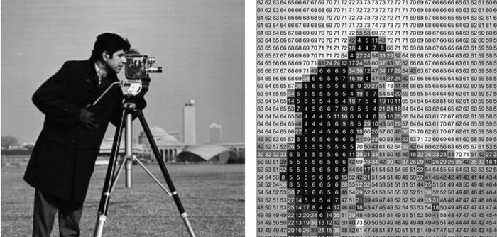
Human vs Machine Perception of an Image

Slide 3
What is Computer Vision??
Reinventing the human eye
Process of extracting information from images/videos
Can be classified into low level and high level

Slide 4
Low Level Computer Vision
Image Sharpening
Edge Detection
Background Subtraction
Contour Detection

Slide 5
High Level Computer Vision
Image Detection
Image Recognition
Image Segmentation

Slide 6
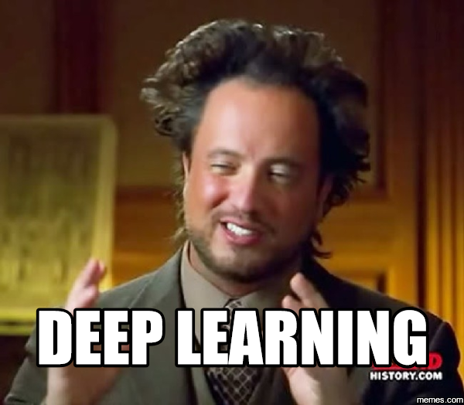
Deep Learning

Slide 7
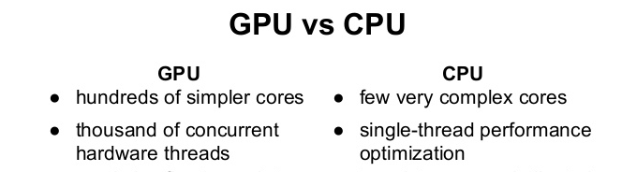
Why a GPU?

Slide 8
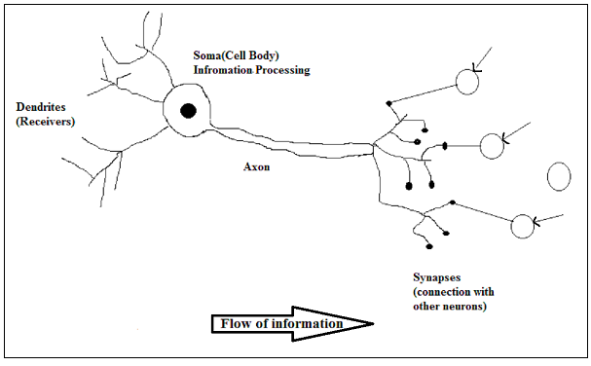
What are neural Networks???
Biological Neural Network

Slide 9
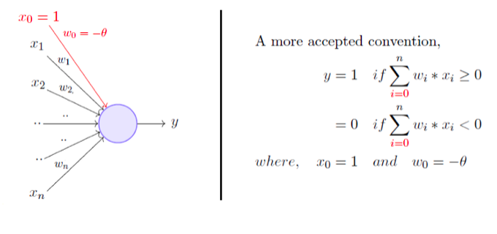
The Perceptron

Slide 10
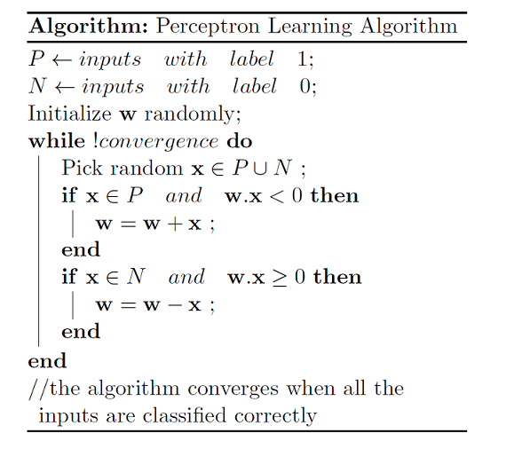
Perceptron Learning Algorithm

Slide 11
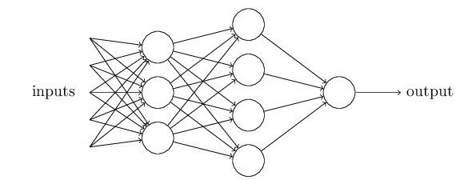
ANNs

Slide 12
The BackProp Algorithm
Proposed by David Rumelhart, Geoffrey Hinton, and Ronald Williams.
Consists of following steps:
Random Weight Initialization
Forward Pass
Backward Pass

Slide 13
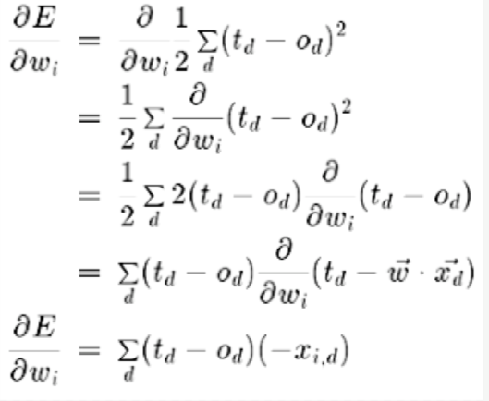
The BackProp Algorithm

Slide 14


Slide 15
Hyperparameter optimization
Learning Rate
Regularization
Selection of Activation Function
DropOut
Selecting Appropriate Cost Function And Optimizer
Batch Normalization

Slide 16
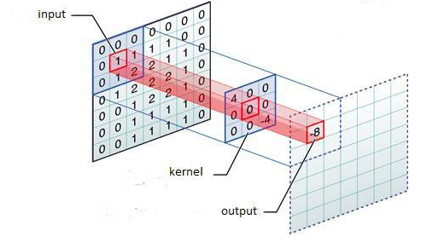
ConvNets
Why CNNs?
Convolution
Pooling Mechanism
Fully Connected Layers

Slide 17
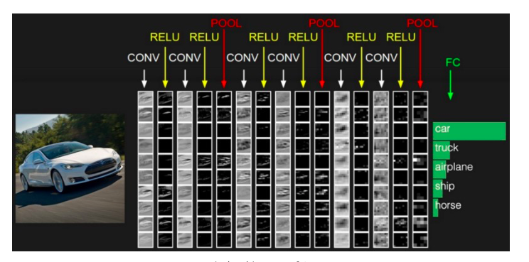
ConvNets
Basic Architecture

Slide 18
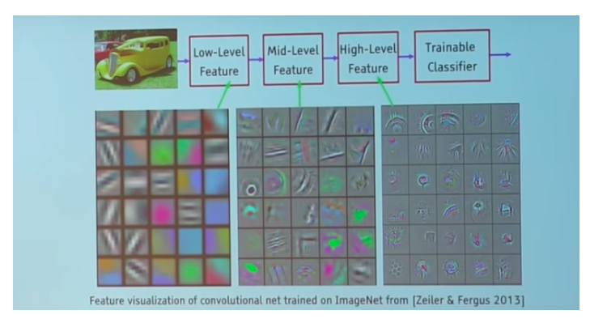
ConvNets
Feature Map

Slide 19
Flavours of ConvNets
Lenet
AlexNet
VGG Net
Inception Nets
ResNets

Slide 20
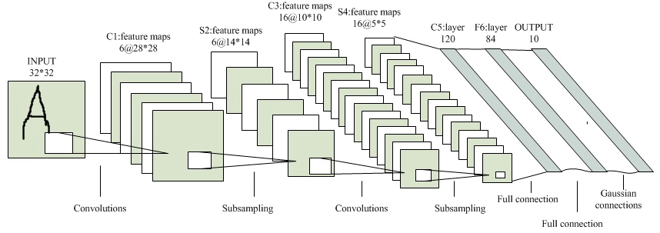
Lenet-5

Slide 21
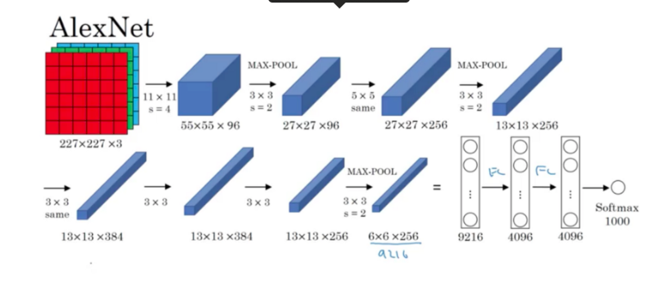
AlexNet

Slide 22
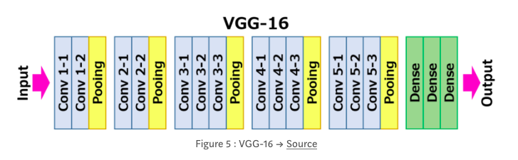
VGG Net

Slide 23
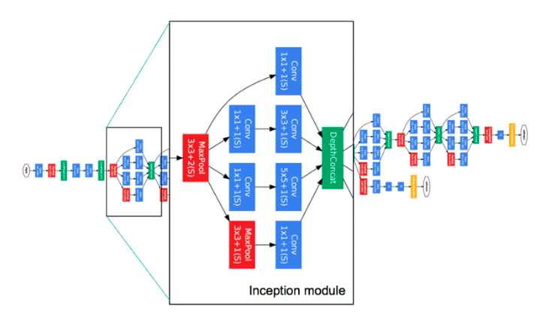
Inception Net

Slide 24
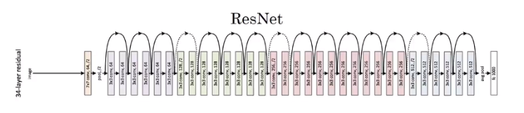
ResNets

Slide 25
Tools for Deep Learning
Theano
Caffe,Caffe2
Tensorflow
Mxnet
Keras

Slide 26
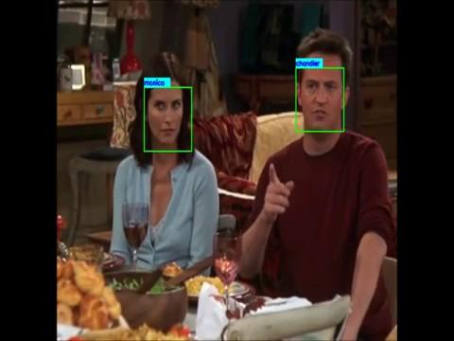
Use Cases
Face Recognition

Slide 27
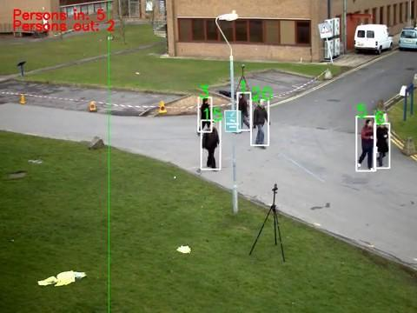
Use Cases
Person Tracking

Slide 28
Questions ???

Slide 29
References
https://towardsdatascience.com/perceptron-learning-algorithm-d5db0deab975
http://neuralnetworksanddeeplearning.com/chap1.html
https://medium.com/@RaghavPrabhu/cnn-architectures-lenet-alexnet-vgg-googlenet-and-resnet-7c81c017b848
http://slazebni.cs.illinois.edu/spring17/lec01_cnn_architectures.pdf

